Slide 1
Machine Learning HACK-A-THON 4/28/2018
DePaul Analytics Group
Senior Lifestyle
Brooksource
Chicago ML group

Slide 2
WELCOME !
DEPAUL ANALYTICS GROUP
Graduate students in the DePaul MS in Predictive Analytics Program
Monica Stettler
President, DePaul Analytics Group
CHICAGO ML meetup GROUP
Garrett Smith
Organizer, Chicago ML Group

Slide 3
LOGISTICS
Bathrooms in back
Drinking fountains on every floor
May work anywhere in building
NOT in labs that look to be in use for another event.
2nd floor has 2 lounges & mezzanine has lounge and board room
Slack channel for communication
use link to find 428hackathon channel):
https://goo.gl/pohpMN

Slide 4
EVENT WIFI
Username: MachineLearningHack
Password: CDMDepaul

Slide 5
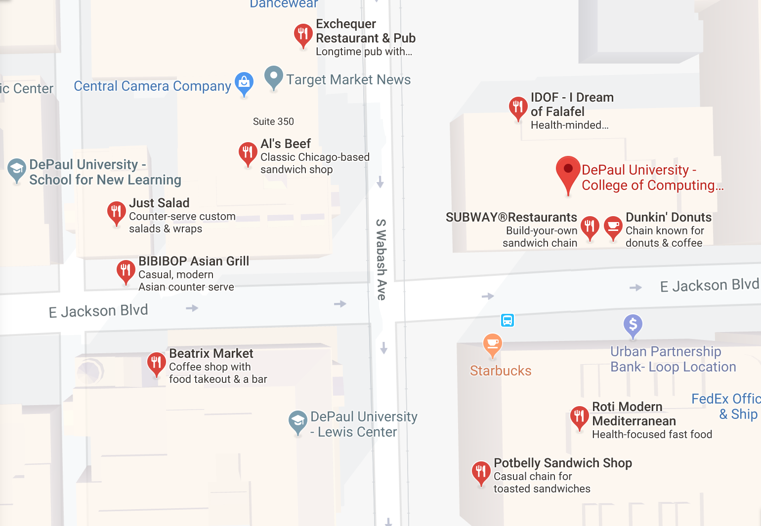
OTHER FOOD & DRINK- if pizza isn’t ur thing

Slide 6

WHAT ARE WE DOING? WHAT IS A HACK-A-THON?
Solving a problem
Understanding the variables
Creating a predictive model(s)
Using machine learning & predictive analytics techniques
Collaborating with others to create a solution

Slide 7
GOALS
Collaborate
Collaborate with people with different points of view, different approaches
Provide
Provide value to Senior Lifestyle by sharing thought process & insights
Apply
Apply data science to a real world problem
Meet
Meet new people, make new friends
HAVE
HAVE FUN!

Slide 8
HOW?
Groups or individual work
Case study
Datasets
5-6 hours
Analyze
Build model
Present results

Slide 9



SPONSORS
DePaul Analytics Group
College of Computing & Digital Media, DePaul University
DePaul Center for Data Mining & Predictive Analytics
Organization, Facilities, Sponsor gifts, Prizes & Catering
Jodi Hill Vice President of Business Strategy
Senior Lifestyle
Challenge & datasets
Sammy Gorbett
Senior Technical Recruiter
Brooksource
Food & refreshments

Slide 10
DEPAUL ANALYTICS BOARD ASSISTING TODAY
Rae Chiang – VP Professional
Alex Yan – VP Marketing
Yan Yu – VP Internal relations
Monica Stettler - President
Akbar Aidarov - Academic Dept

Slide 11
MENTORS
Tim Scharf – Senior Machine Learning Engineer, Uptake
Mak Hozo – Data Scientist, Chicago Public Schools
Max Li – Data Scientist, Uptake
Wenbo Zhao – Data Scientist, Coyote Logistics
Ray Li – Data Scientist, CCC Information Services
Matt Winkler – Analytics Manager, Wyzant
Jeremy Mobley – Data Scientist, DRIVIN
Minh Tran –MSPA, graduating June
Ivy Yun – MSPA, graduating June
Andrew Kos – Web developer, Sprout Social & MSPA graduate student
Garrett Smith – Chicago ML Group

Slide 12
AGENDA
9:00am Kickoff & Introduction
9:20am Create Groups and get started
12:00pm Lunch arrives (Pizza, soda, coffee, tea, water)
3:00pm Cookies, coffee, tea arrives
Groups wishing to present their results need to submit team
member names and title to Monica
3:30pm Presentations begin (upload slides to the 428hackathon google
drive folder
4:50pm Choose winner, present prize & wrap up

Slide 13
INTRODUCTION to SENIOR LIFESTYLE & CHALLENGE
Jodi Hill Vice President of Business Strategy
Senior Lifestyle
CHALLENGE:
“PREDICTING PROSPECTIVE CUSTOMER CONVERSIONS”

Slide 14
GROUP FORMATION
RECOMMENDATIONS:
When I say go, you will get up and meet people, speed dating style.
*Mix it up
Experienced with inexperienced
DePaul with ML group
*Not more than 5 in a group
*Individual work is fine
Mentors are available to help you find a group, if needed.

Slide 15
LINK TO CASE STUDY & DATASETS
https://goo.gl/7gvy6n

